Slide 1


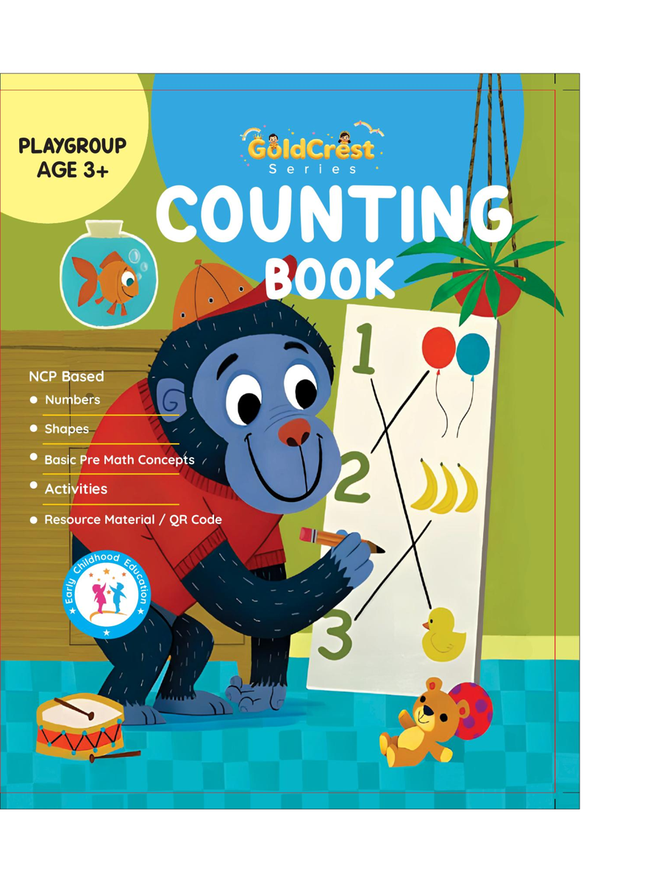
GoldCrest Counting Book
Playgroup • Age 3+
An activity-based early-years book from the GoldCrest Series.
A Project of Azhar Publishers & Book Factory

Slide 2
i
What's Inside
GoldCrest Counting Book Playgroup • Age 3+
1
Numbers 1–20 with themed pictures
2
Number tracing
3
Counting and matching quantities
4
Concepts: thick / thin, heavy / light
5
Concepts: full / empty, more / less
6
Simple, playful practice

Slide 3
★
Purpose & Classroom Support
Introduces first numbers, counting and comparison concepts in a gentle, picture-led way.
“
Every book comes with
1
2
3
Teacher's Lesson Plan
Practice Papers
Digital Interactive Version
A 40-week lesson plan that guides teachers, day by day.
Monthly tests and term exam papers for children to attempt.
An interactive flipbook and digital exercises for engaging, screen-based practice.
A Project of Azhar Publishers & Book Factory

